Slide 1
Genetic Algorithm with Tree Search for
Traveling Salesman Problem
Team#2 / 송현섭
/ 이시현
/ 박민준

Slide 2
Index
Genetic Algorithm
a. Structure
b. Experiment
2. Tree Search
a. Structure
b. Main Idea
c. Experiment
3. Furthermore

Slide 3
Genetic Algorithm
초기집단
적합도 함수 : 거리 순 오름차순
초기 데이터셋 : 100
Iterator : 1000
선택 연산
교차 연산
변이 연산
Output

Slide 4
Genetic Algorithm
선택 연산
Sorted set – 100EA
Selected set – 100EA
1st : 0.15
100Times
2nd : 0.14
3rd : 0.13
4th : 0.12
10th : 0.05

Slide 5
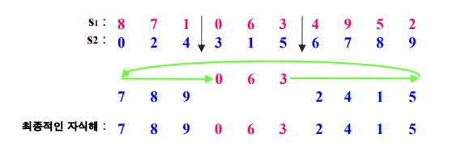
Genetic Algorithm
교차 연산
100EA
100EA
S1
[0]
S2
[1]
[0]
Output
[1]
S1
[1]
S2
[0]

Slide 6
Genetic Algorithm
변이 연산
Random Index
Input[0]
1
2
3
4
5
1
2
3
4
5
5
4
3
2
1
Output[0]
5
4
3
2
1

Slide 7
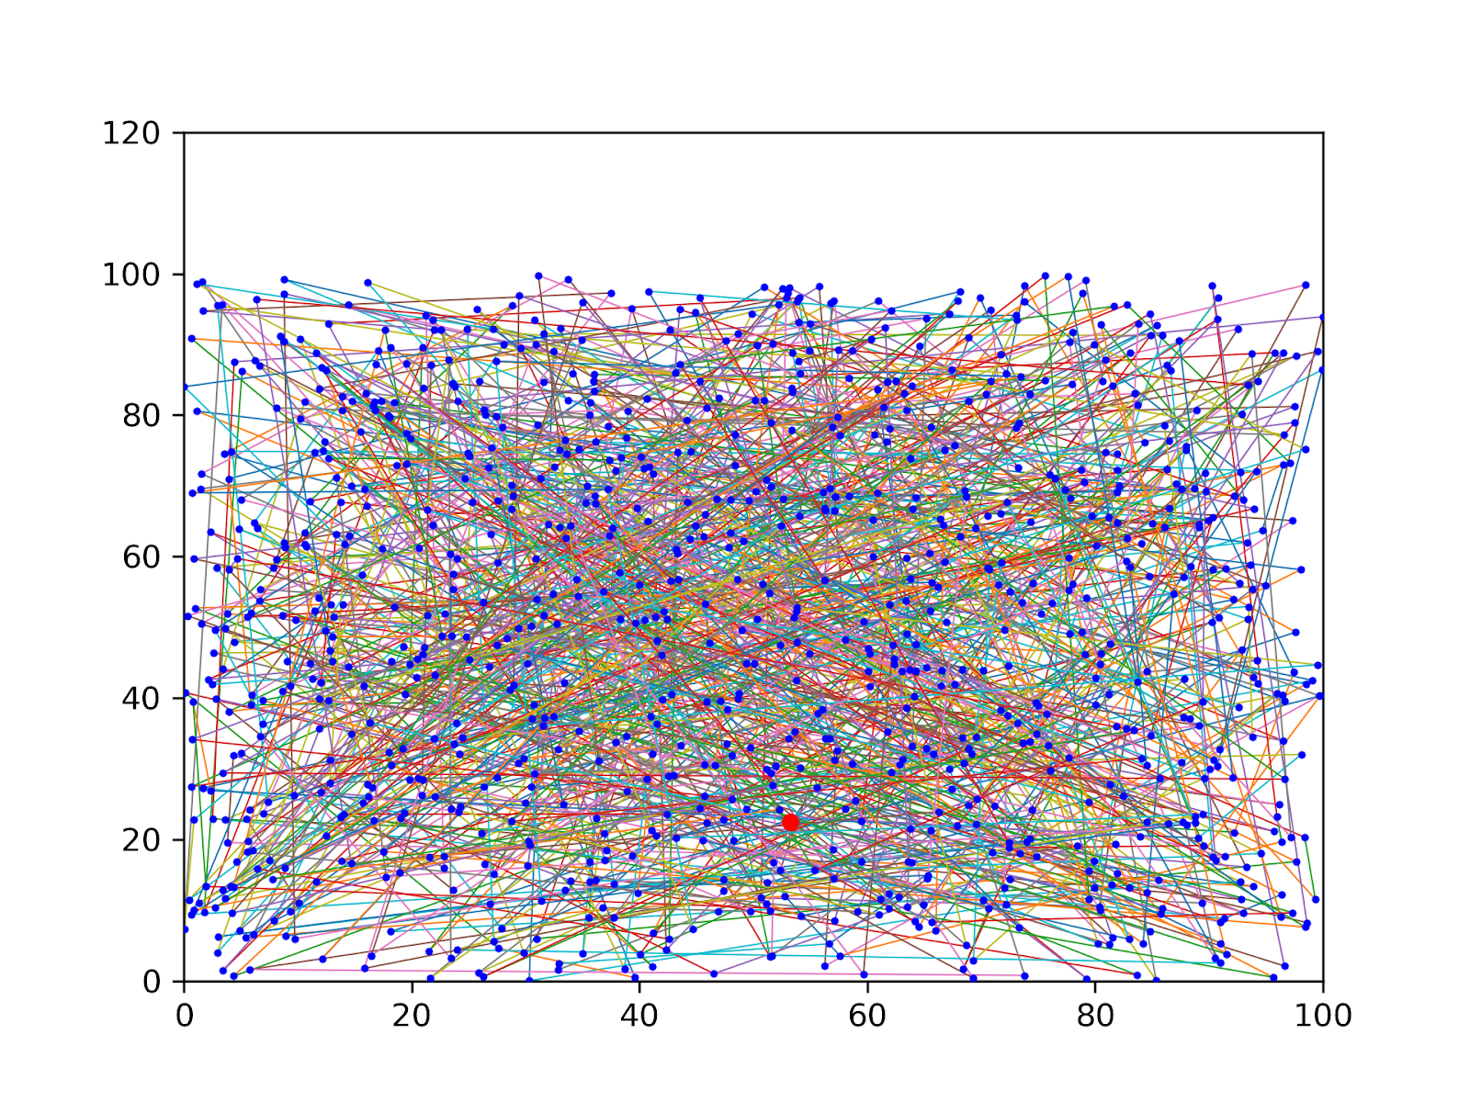
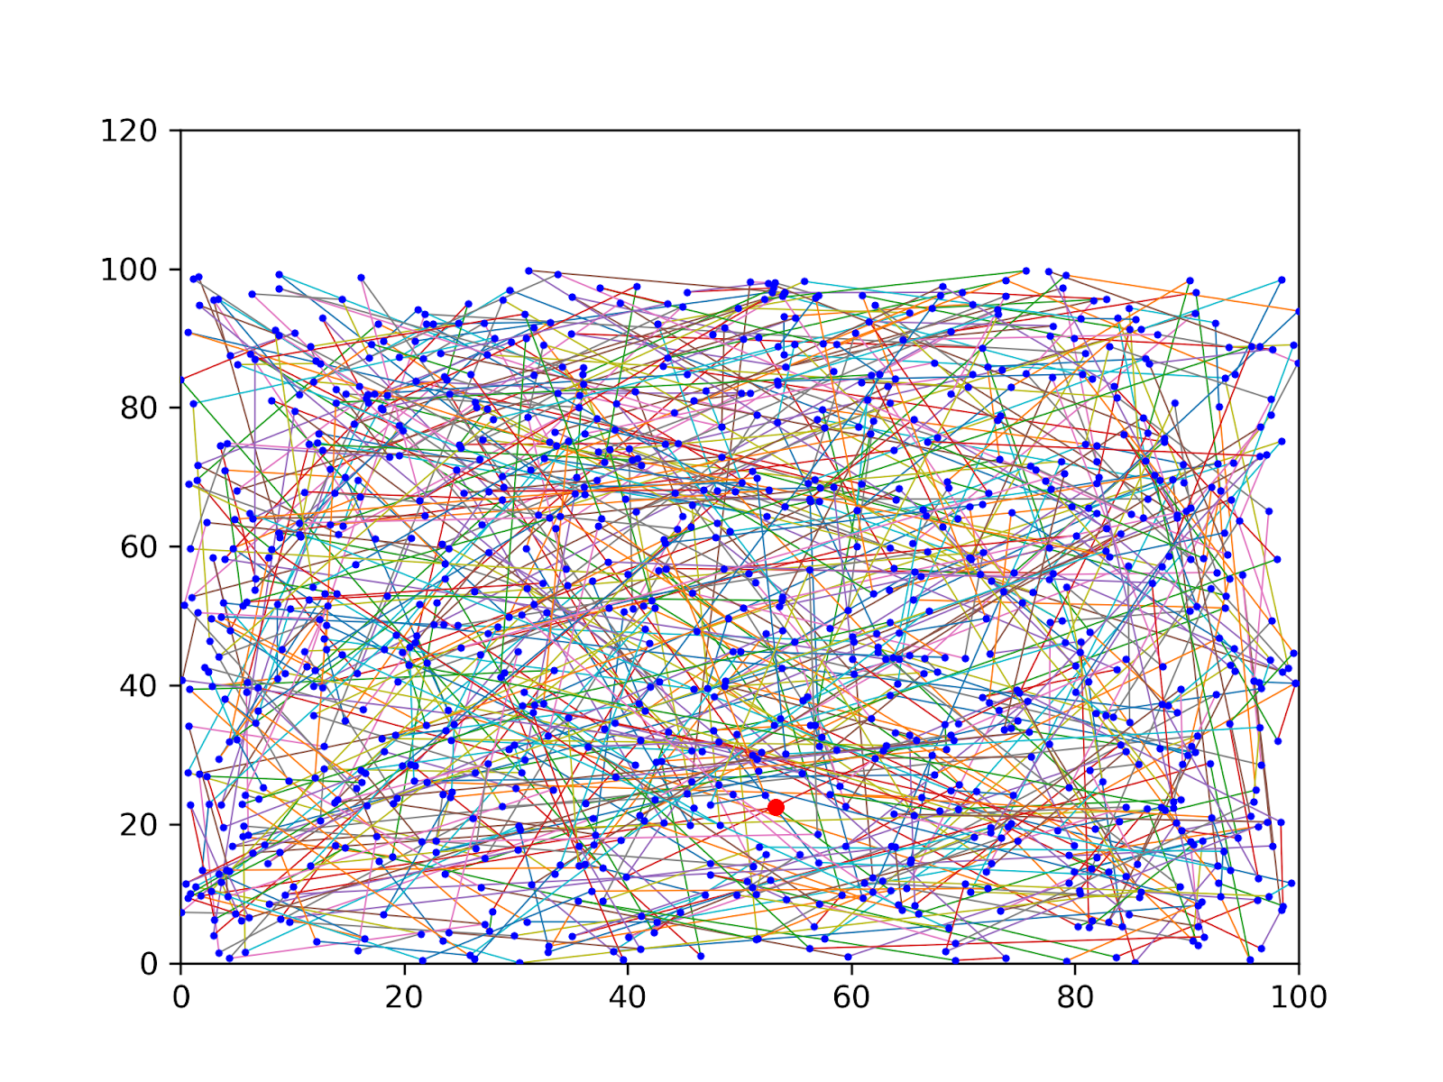
Genetic Algorithm
Result
<Fig. RandomSearch_Score : 50572>
<Fig. RandomSearch_GA_Score : 24232>

Slide 8
Tree Search
Random Search
Tree Search
Now
Next
Now
Next
}
}
None Visit
Whole Node
None Visit
Best {Threshold}
Node
Threshold = 3

Slide 9
Tree Search
Main Idea : How to Select Best Node?
1. Nearest Neighbor
*
2. Best Score Node :
Score = Distance * Degree score

Slide 10
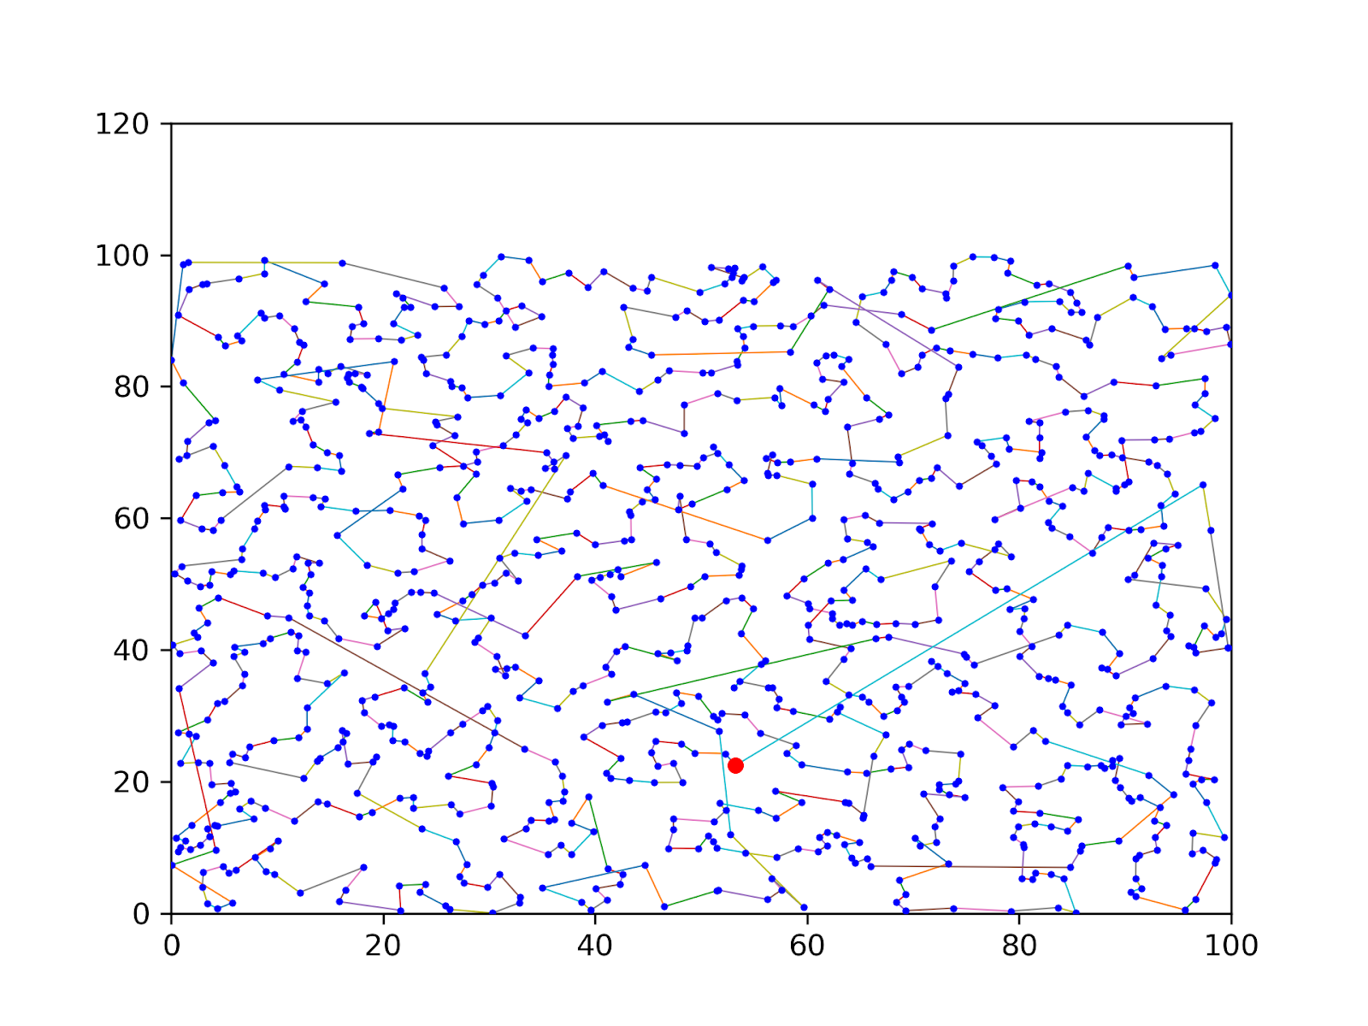
Tree Search
1. Nearest Neighbor
Nearest Neighbor
Best Case
(Threshold = 1)
<Fig. Tree_NoDegree_Score : 2800>

Slide 11
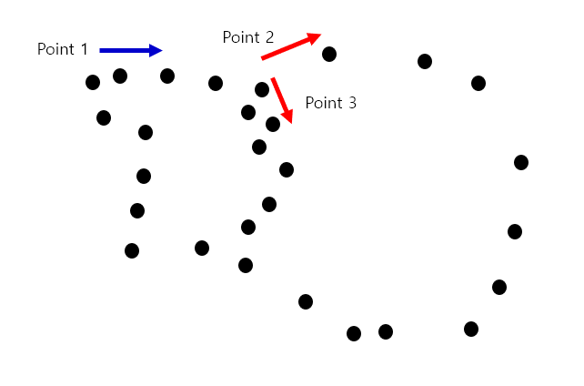
Tree Search
2. Best Score Node : Score = Distance * Degree score
Why Degree?
Try to Search Widely
With Degree : 1 -> 2
Distance Only : 1 -> 3

Slide 12
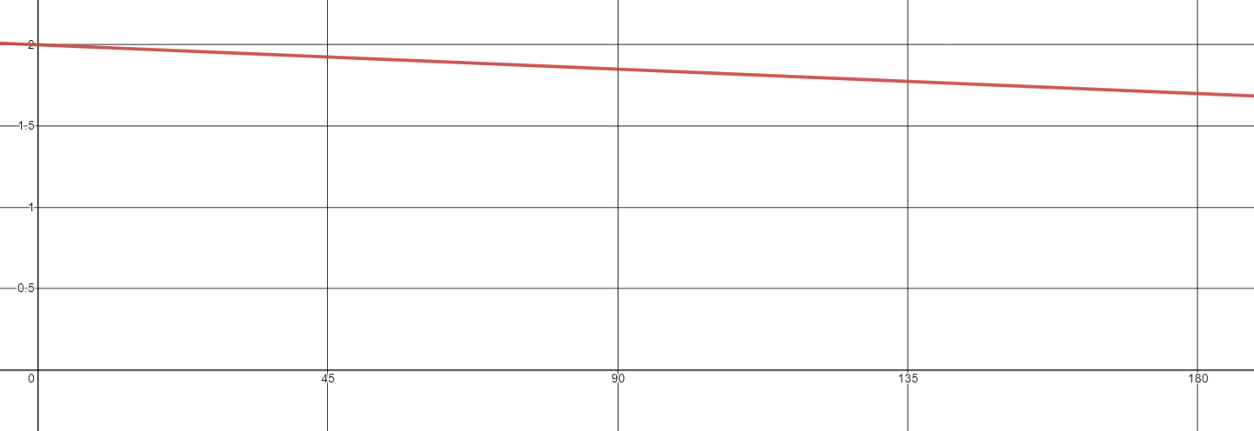
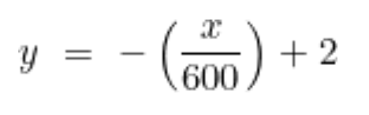
Tree Search
2. Best Score Node : Score = Distance * Degree score
How Apply Degree?
Now
Pre
Score = Distance * Degree score
Next
Best (W,b) = (-1/600, 2)
Degree score = Wx + b
X = {0 ~ 180}
X = {0 ~ 180}
Y = {2 ~ 1.7}

Slide 13
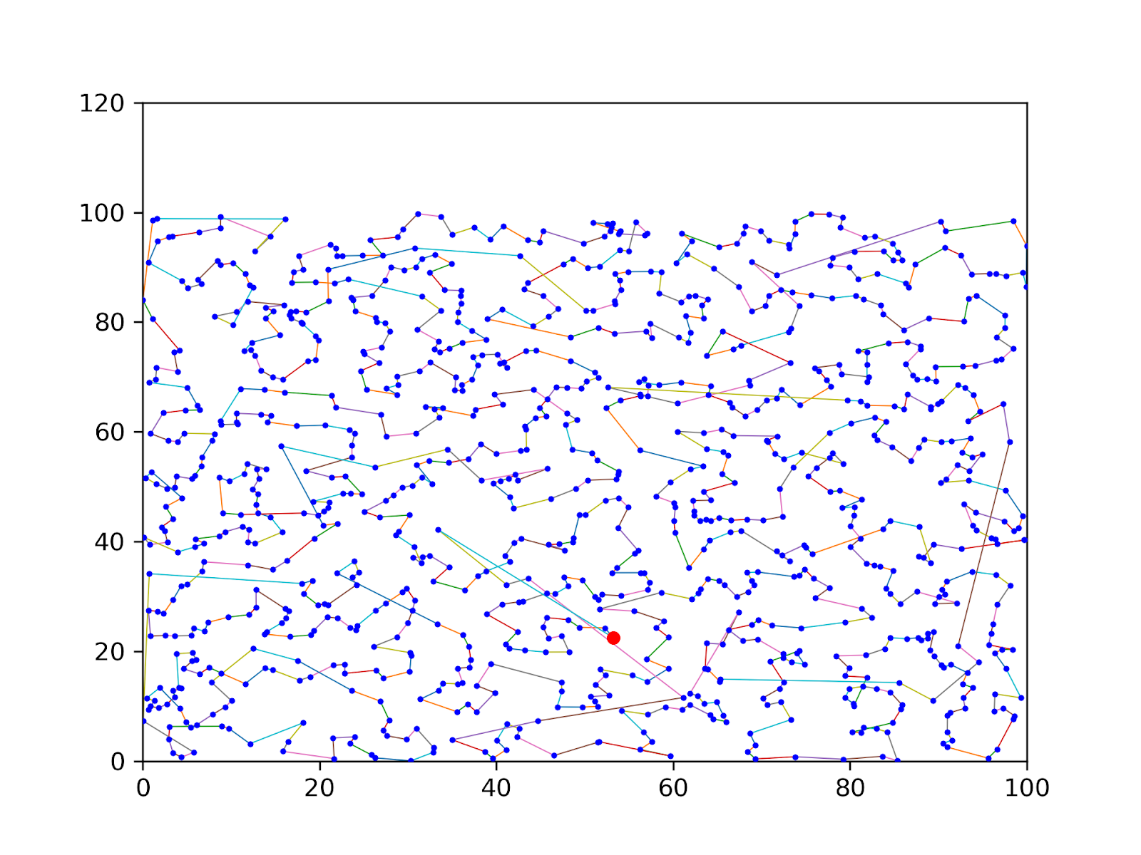
Tree Search
2. Best Score Node : Score = Distance * Degree score
Best Score Node
Can be optimized with
another Degree score
Furthermore..
<Fig. Tree_Degree_Score : 2767>

Slide 14
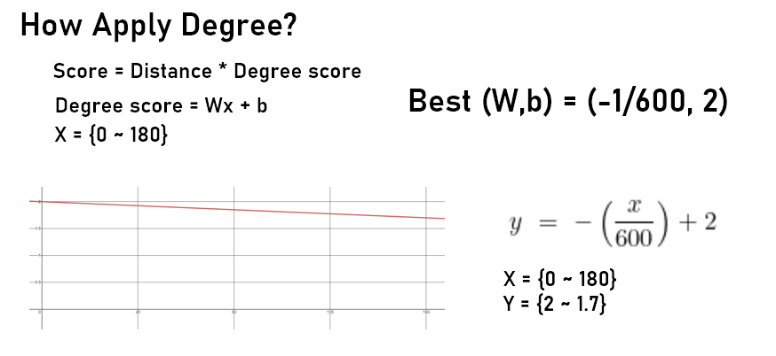
Furthermore
Best (W,b) =
Only for one Dataset
Using Deep Learning Optimize Degree score = Wx + b
For another Dataset

